Slide 1
Double Linked List and Circular Linked List

Slide 2
Introduction to Doubly Linked List
We have discussed the details of linear linked list. In the linear linked list, we can only traverse the linked list in one direction.
But sometimes, it is very desirable to traverse a linked list in either a forward or reverse manner.
This property of a linked list implies that each node must contain two link fields instead of one.
The links are used to denote the predecessor and successor of a node.
The link denoting the predecessor of a node is called the left link, and that denoting its successor its right link

Slide 3
Basic Operation of Doubly Linked List
Insert: Add a new node in the first, last or interior of the list.
Delete: Delete a node from the first, last or interior of the list.
Search: Search a node containing particular value in the linked list.

Slide 4
Insertion
Insertion is to add a new node into a linked list. It can take place anywhere:
The first position
The last position
Any interior position

Slide 5
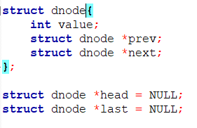
Initial Scenatio
Head
last
NULL
NULL

Slide 6
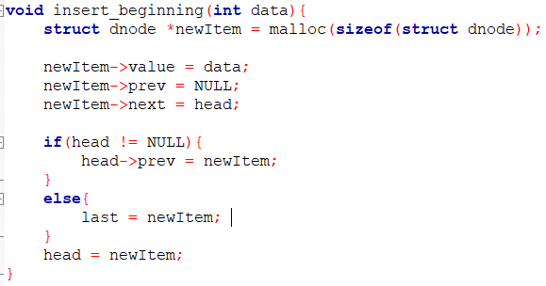
Insert First
Head
last
NULL
NULL

Slide 7
Insert First
Head
last
NULL
NULL
newItem

Slide 8
Insert First
Head
last
NULL
NULL
newItem

Slide 9
Insert First
Head
last
NULL
NULL
newItem
5

Slide 10
Insert First
Head
last
NULL
NULL
newItem
NULL
5

Slide 11
Insert First
Head
last
NULL
NULL
newItem
NULL
5
NULL

Slide 12
Insert First
Head
last
NULL
NULL
newItem
NULL
5
NULL

Slide 13
Insert First
Head
NULL
newItem
last
NULL
5
NULL

Slide 14
Insert First
Head
newItem
last
NULL
5
NULL

Slide 15
Insert First
THE LIST IS NO LONGER EMPTY
Head
newItem
last
NULL
5
NULL

Slide 16
Insert First
newItem
NULL
50
Head
newItem
last
NULL
5
NULL

Slide 17
Insert First
newItem
NULL
50
Head
newItem
last
NULL
5
NULL

Slide 18
Insert First
newItem
NULL
50
Head
newItem
last
NULL
5
NULL

Slide 19
Insert First
newItem
NULL
50
Head
newItem
last
5
NULL

Slide 20
Insert First
Head
newItem
newItem
last
NULL
50
5
NULL

Slide 21
Insert First
Head
newItem
newItem
last
NULL
50
5
NULL

Slide 22
Insert First
Head
newItem
newItem
last
NULL
50
5
NULL

Slide 23
Insert First
Head
last
NULL
50
5
NULL

Slide 24
Insert Last
Try writing the function yourself.
Consider the case where the list is empty
Consider the case where the list is not empty
Be sure to deal with all the pointers

Slide 25
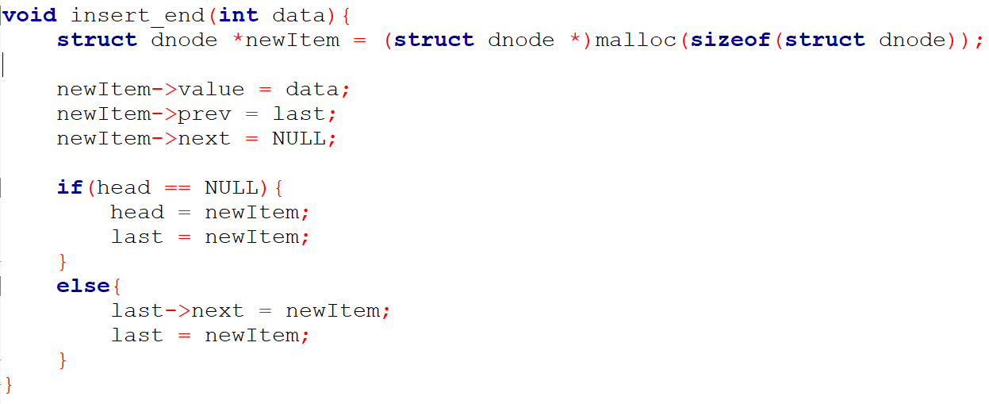
Insert Last

Slide 26
Search Function
We will this function to search for a particular node.
The function will return a pointer to that node.
Try it yourself

Slide 27
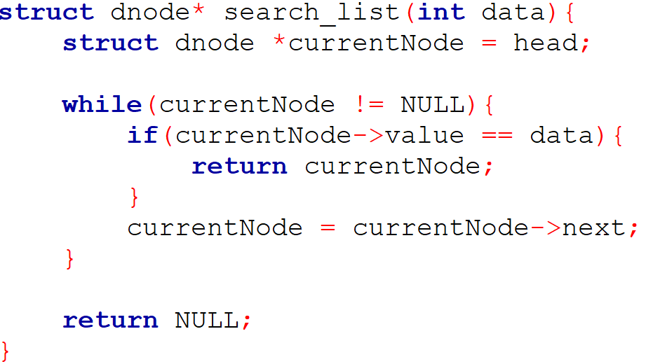
Search Function
We will this function to search for a particular node.
The function will return a pointer to that node.

Slide 28
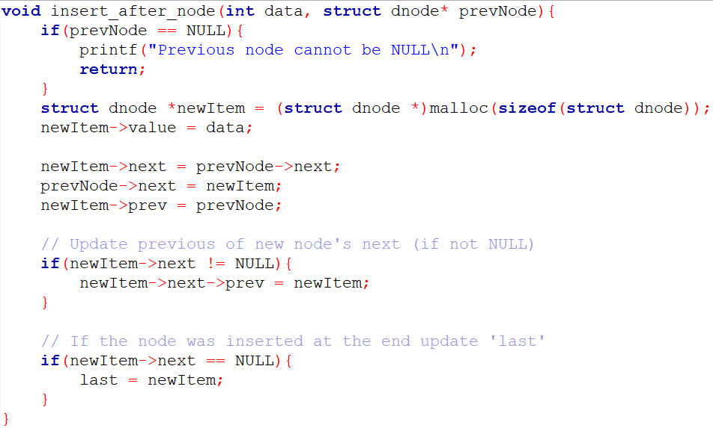
Insert After Function

Slide 29
Insert After Function
last
head
5
4
2

Slide 30
Insert After Function
last
head
5
4
2
Search(4);

Slide 31
Insert After Function
last
head
ptr
5
4
2
ptr=Search(4);

Slide 32
Insert After Function
last
head
ptr
5
4
2
ptr=Search(4);
Insert_after_node(50,ptr);

Slide 33
Insert After Function
last
head
prevNode
5
4
2
newItem
50

Slide 34
Insert After Function
last
head
prevNode
5
4
2
newItem
50

Slide 35
Insert After Function
last
head
prevNode
5
4
2
newItem
50

Slide 36
Insert After Function
last
head
prevNode
5
4
2
newItem
50

Slide 37
Insert After Function
last
head
prevNode
5
4
2
newItem
50

Slide 38
Insert After Function
last
head
prevNode
5
4
2
newItem
50

Slide 39
Insert After Function
last
head
prevNode
5
4
2
newItem
50

Slide 40
Insert After Function
last
head
5
4
50
2

Slide 41
Insert After Function
last
head
ptr
5
4
2
ptr=Search(2);
Insert_after_node(50,ptr);

Slide 42
Insert After Function
last
head
prevNode
5
4
2
newItem
50

Slide 43
Insert After Function
last
head
prevNode
5
4
2
NULL
newItem
50

Slide 44
Insert After Function
last
head
prevNode
5
4
2
NULL
newItem
50

Slide 45
Insert After Function
last
head
prevNode
5
4
2
NULL
newItem
50

Slide 46
Insert After Function
last
head
prevNode
5
4
2
NULL
newItem
50

Slide 47
Insert After Function
last
newItem
head
5
4
2
50
NULL

Slide 48
Insert After Function
last
newItem
head
5
4
2
50
NULL

Slide 49
Deletion
Deletion is to remove a node from a list. It can also take place anywhere -- the first, last, or interior of a linked list.
To delete a node from a double linked list is easier than to delete a node from a linear linked list.
For deletion of a node in a single linked list, we have to search and find the predecessor of the discarded node.
But in the double linked list, no such search is required.
Given the address (obtained from the search function) of the node that is to be deleted, the predecessor and successor nodes are immediately known

Slide 50
Deletion
First, let us check if the provided node is NULL.
Next, let us check if the node is the first in the list (i.e., it has no previous node).
If the node to be deleted is the first node, it sets the head of the list to be the next node.
If it's not the first node, the function sets the next pointer of the previous node to the node after the node to be deleted, effectively skipping over the node to be deleted in the list.
Then we need to check whether there is a node after the node to be deleted.
Finally, we need to free the target node from the memory.

Slide 51
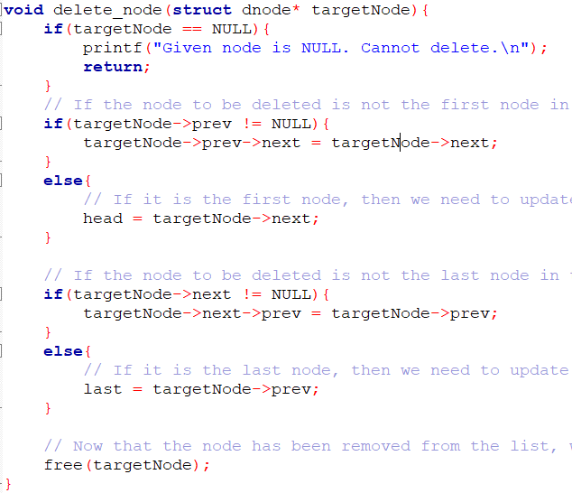
Delete A Target Node

Slide 52
Delete A Target Node
last
head
5
4
2
targetNode

Slide 53
Delete A Target Node
Target Case 1: It is not the first node
last
head
5
4
2
targetNode

Slide 54
Delete A Target Node
Target Case 1: It is not the first node
last
head
5
4
2
targetNode

Slide 55
Delete A Target Node
Successor Case 1: It is not NULL
last
head
5
4
2
targetNode

Slide 56
Delete A Target Node
Successor Case 1: It is not NULL
last
head
5
4
2
targetNode

Slide 57
Delete A Target Node
Successor Case 1: It is not NULL
last
head
5
4
2
targetNode

Slide 58
Delete A Target Node
Successor Case 1: It is not NULL
last
head
5
2

Slide 59
Delete A Target Node
Successor Case 1: It is not NULL
last
head
5
4
2
targetNode

Slide 60
Delete A Target Node
Target Case 2: It is the first node
last
head
5
4
2
targetNode

Slide 61
Delete A Target Node
Target Case 2: It is the first node
last
head
5
4
2
targetNode

Slide 62
Delete A Target Node
Successor Case 1: It is not NULL
last
head
5
4
2
targetNode

Slide 63
Delete A Target Node
Successor Case 1: It is not NULL
last
head
5
4
2
NULL
targetNode

Slide 64
Delete A Target Node
Successor Case 1: It is not NULL
last
head
4
2
NULL

Slide 65
Delete A Target Node
Target Case 1: It is not the first node
last
head
5
4
2
targetNode

Slide 66
Delete A Target Node
Target Case 1: It is not the first node
last
head
5
4
2
NULL
targetNode

Slide 67
Delete A Target Node
Target Case 1: It is not the first node
last
head
NULL
5
4
2
NULL
targetNode

Slide 68
Delete A Target Node
Successor Case 1: It is not NULL
last
head
NULL
5
4
2
NULL
targetNode

Slide 69
Delete A Target Node
Successor Case 1: It is not NULL
last
head
NULL
5
4
2
NULL
targetNode

Slide 70
Delete A Target Node
Successor Case 1: It is not NULL
last
head
NULL
5
4

Slide 71
Advantages/Disadvantages of Doubly Linked List
Advantages over singly linked list:
A DLL can be traversed in both forward and backward direction.
We can quickly insert a new node before a given node.
The delete operation in DLL is more efficient if pointer to the node to be deleted is given. ○
In singly linked list, to delete a node, pointer to the previous node is needed. To get this previous node, sometimes the list is traversed. In DLL, we can get the previous node using ‘prev’ pointer.
Disadvantages over singly linked list:
Every node of DLL require extra space for an previous pointer.
All operations require an extra pointer ‘prev’ to be maintained.

Slide 72
CIRCULAR LINKED LIST

Slide 73
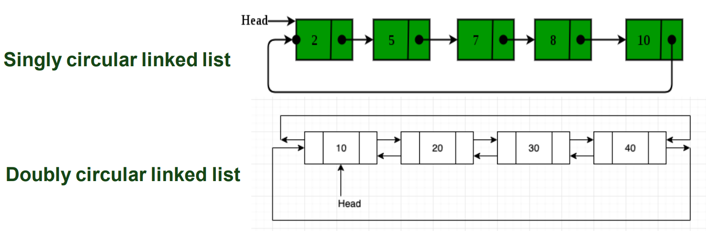
Circular Linked List
In a circular linked list every element has a link to its next element and the last element has a link to the first element.

Slide 74
Single Circular Linked List
To implement a circular singly linked list, we take a global pointer that points to the last node instead of the Head node.
Why ?
For the insertion at the beginning, the whole list has to be traversed.
Also, for insertion at the end, the whole list has to be traversed.
If we take a pointer to the last node, then in both cases there won’t be any need to traverse the whole list.

Slide 75
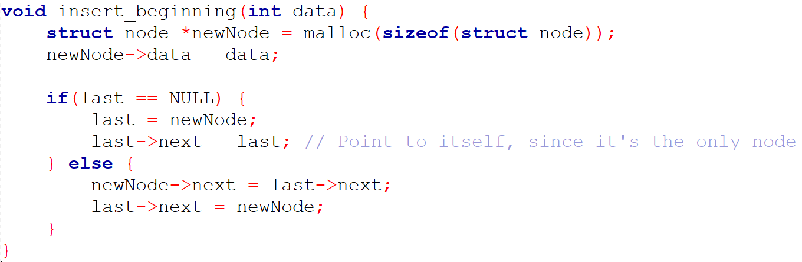
Single Circular Linked List
INSERT BEGINNING

Slide 76
Single Circular Linked List
INSERT beginning

Slide 77
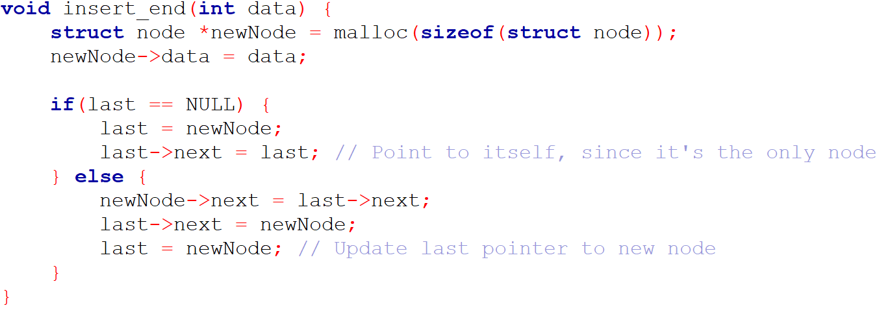
Single Circular Linked List
INSERT END

Slide 78
Single Circular Linked List
INSERT END

Slide 79
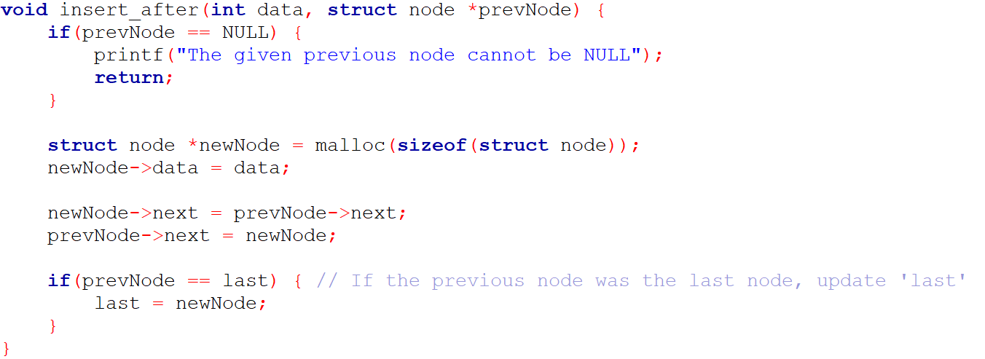
Single Circular Linked List
INSERT AFTER

Slide 80
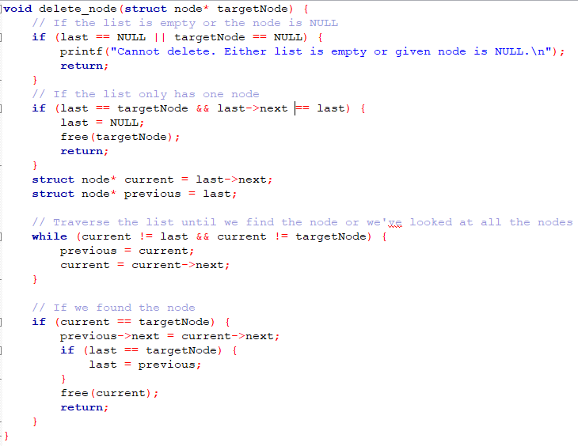
SINGLE CIRCULAR LINKED LIST

Slide 81
Summary of Linked Lists
Advantages:
Linked List is dynamic data structure, that is, the Linked List grows dynamically.
Insertion into Linked Lists and deletion from Linked Lists are very fast (O(1) time considering that search took place ).
Disadvantages:
Linked List is a sequential access data structure.
Searching an element by pointers is very slow (O(n) time)
A Linked List is a suitable structure when
A lot of insertions and deletions are required.
A small number of searching and retrieval are required.

Slide 82
Thank You

